Slide 1
TEAM NAME: CyberHawk
Project Name: FreshFarm
Team members :
Komal Pal
Harmandeep Singh
Akash Yadav
Ajay Kumar
Pinaq Sharma

Slide 2
Prototype
Software
Website
Over the
Network
Displays and Informs
Interactive interface between user and producer
Hardware
Sensors, ESP8266 and Arduino
Raw Data of Fruits and vegetables

Slide 3
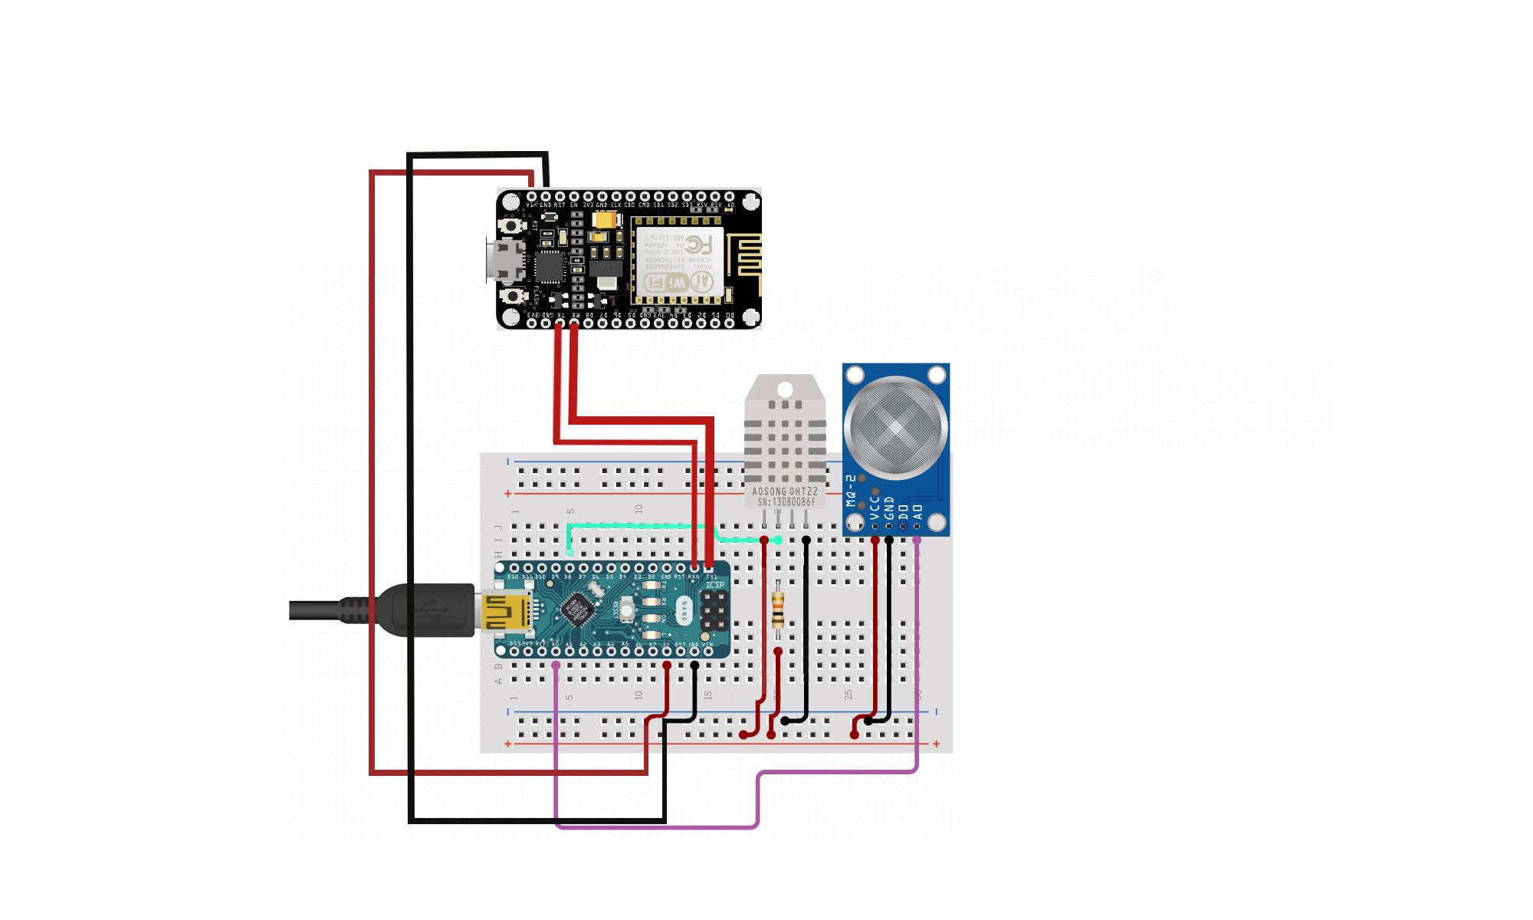
Sensor Circuit
NodeMCU
DHT-11
MQ-3
Arduino NANO

Slide 4
Workflow
The process starts when the farmer adds the amount of available produce.
User places the order as per his/her own requirements.
The order is forwarded to the farmer who prepares for the shipping of the produce after packaging and requesting for delivery.
The delivery agent arrives at the farmer's address and receives the goods.
While the product reaches the customer's home with the sensors placed in the shipping container of the delivery agent takes the reading and transmits them to the application server.
This data includes the raw information of the sensor readings taken from DHT-11 ang MQ-3 sensor.
This data is then provided to the customer after the processing is done

Slide 5
TECHNOLOGY USED
FRONT END : HTML,CSS,Javascript,Bootstrap
BackEnd : Django
Hardware Used:
Arduino: server data provider
ESP8266(NODE MCU): IOT device to facilitate communication between arduino and server
DHT-11: temperature and humidity sensor
MQ3:gas sensor

Slide 6
USE CASES
Platform for direct selling
To facilitate farmers and users to get a fair price by cutting out the middle-man.
Support locals by giving them provisions for selling their own fruits and vegetables and supporting kitchen gardening
Moreover affecting GDP
Promoting usage of organic products.
Using applications of IoT to get the estimated quality of fruits and vegetables during shipping.

Slide 7
DEPENDENCIES
Arduino IDE
Django Interface

